Slide 2
Performance Analysis.
There are many Criteria to judge an algorithm.
– Is it correct?
– Is it readable?
– How it works
Performance evaluation can be divided into two major phases.
1. Performance Analysis (machine independent)
– space complexity: The space complexity of an algorithm is the amount of memory it needs to run for completion.
– time complexity: The time complexity of an algorithm is the amount of computer time it needs to run to completion.

Slide 3
2 .Performance Measurement (machine dependent).
Space Complexity:
The Space Complexity of any algorithm P is given by S(P)=C+SP(I),C is constant.
1.Fixed Space Requirements (C)
Independent of the characteristics of the inputs and outputs
– It includes instruction space
– space for simple variables, fixed-size structured variable, constants
2. Variable Space Requirements (SP(I))
depend on the instance characteristic I
– number, size, values of inputs and outputs associated with I
– recursive stack space, formal parameters, local variables, return address

Slide 4
Examples:
*Program 1 :Simple arithmetic function
Algorithmabc( a, b, c)
{
return a + b + b * c + (a + b - c) / (a + b) + 4.00;
}
SP(I)=0
HenceS(P)=Constant

Slide 5
Program 2: Iterative function for sum a list of numbers
Algorithm sum( list[ ], n)
{
tempsum = 0;
for i = 0 ton do
tempsum += list [i];
return tempsum;
}

Slide 6
*Program 3: Recursive function for sum a list of numbers
Algorithmrsum( list[ ], n)
{
If (n<=0) then
return 0.0
else
return rsum(list, n-1) + list[n];
}

Slide 7
Methods to compute the step count:
1) Introduce variable count into programs
2) Tabular method
– Determine the total number of steps contributed by each statement
step per execution  frequency
– add up the contribution of all statements

Slide 8
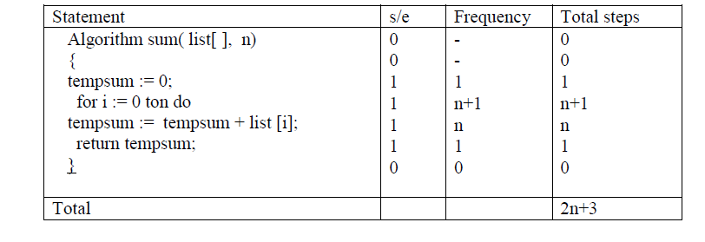
II Tabular method.
Complexity is determined by using a table which includes steps per execution(s/e) i.e
amount by which count changes as a result of execution of the statement.
Frequency – number of times a statement is executed.

Slide 9
Complexity of Algorithms
The complexity function f(n) for certain casesare:
1. Best Case : The minimum possible value of f(n) is called the best case.
2. Average Case : The average value off(n).
3. Worst Case : The maximum value of f(n) for any key possible input.
The field of computer science, which studies efficiency of algorithms, is known as analysis of algorithms.

